Slide 1

METABOLIC EPILEPSIES
Dylan Brock, MD MA
Assistant Professor
Pediatric Neurology
UofL School of Medicine
Norton Children’s Neurosciences Institute

Slide 2
Disclosures
No relevant financial disclosures

Slide 3
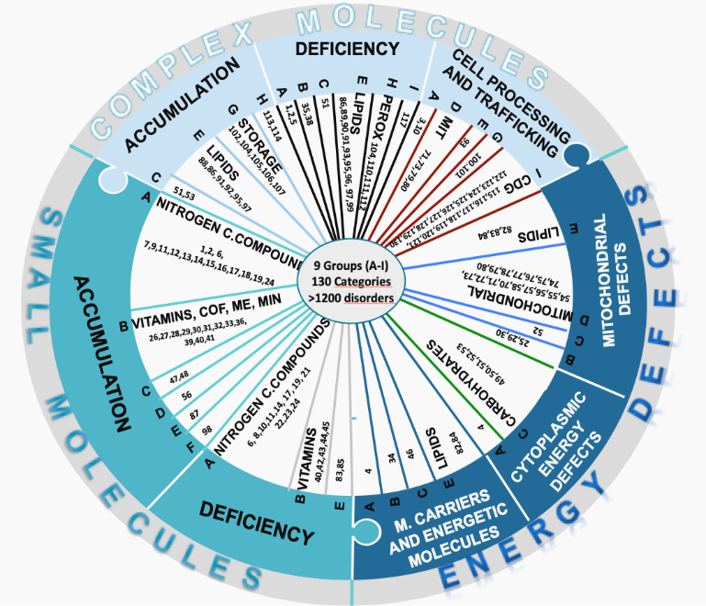
>1200 deficits

Slide 4
Pyridoxine-Dependent Epilepsy (PDE)
Initial presentation: Severe seizures unresponsive to standard anticonvulsants
Therapeutic trial: High-dose pyridoxine (30mg/kg or 100 mg)
Biochemical mechanism: Deficiency in antiquitin, affecting lysine degradation pathway
Genetic findings: Mutation in ALDH7A1 gene
Atypical presentations: Long asymptomatic periods, late-onset cases

Slide 5
Pyridoxine Responsive Seizures
First reported in 1954
Onset of seizures in a newborn at DOL 1
Incidental treatment with 5 days of IM of berocca C® and seizures improved
Thiamine, niacinamide, gentisic acid, ethanolamid, B6
Systematic withdraw of each component and seizures responsive to only B6 (pyridoxine)
PRS often defined by the absence of clinical seizures or EEG improvement following B6 supplementation
Hunt, Stokes et al, J Peds, 1954

Slide 6
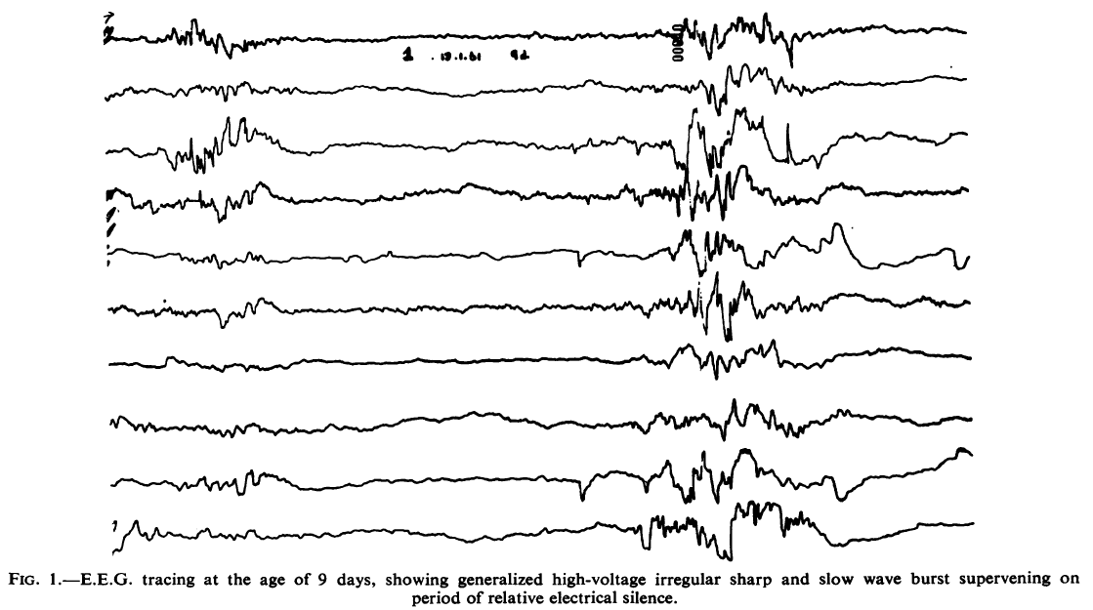
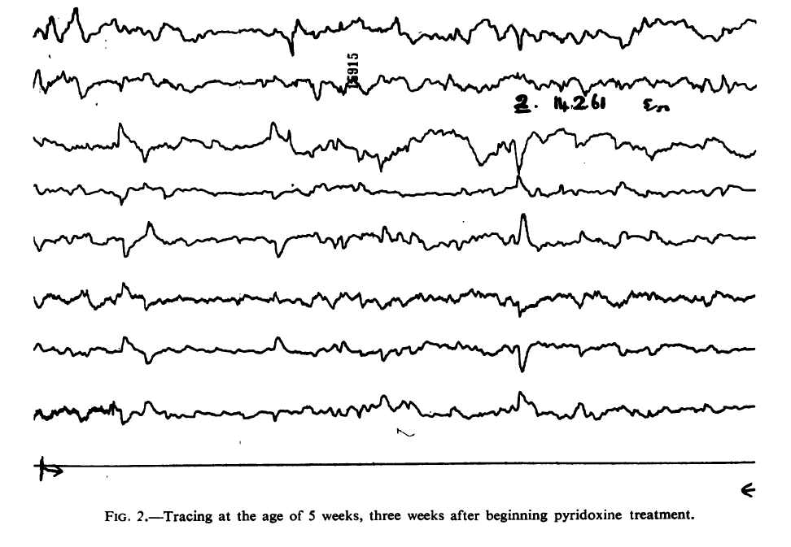
Diagnosis of pyridoxine responsive seizures
Prior to treatment with pyridoxine
Three Weeks After Treatment
(5 mg pyridoxine IM, 2-5 mg oral)
Garty et al, Arch Dis Child, 1962

Slide 7
Pyridoxine Responsive EpilepSIES
Disorder | Gene | B6 Treatment | Outcome
Pyridox(am)ine-5’-phosphate oxidase (PNPO) defcieincy | PNPO | Pyridoxal phosphate Pyridoxine | High mortality Good outcome if diagnosed and treated early
Pyridoxine Dependent Epilepsy (PDE) | ALDH7A1 | Pyridoxine | ID in ~75% of patients (IQ<70) New therapies lead to improved outcomes
PLP binding protein | PROSC | Pyridoxine | Described in 2017 Majority normal outcome
Hypophosphatasia | ALPL | Pyridoxine | Seizure control Lethal bone disease
Familial Hyperphosphatasia | PIGV | Pyridoxine | Seizure control DD/ID
Hyperprolinemia II | ALDH4A1 | Pyridoxine | Seizure control DD/ID

Slide 8
Pyridoxine-responsive seizures
DEFECT | Pyridoxine-dependent epilepsy | PNPO deficiency | TNS-ALP deficiency (6 phenotypes) | PIGV deficiency | P5CD deficiency
FUNCTION | Lysine degradation | Extracellular PLP formation | Bone mineralization; B₆ uptake | GPI anchor | Proline degradation
PRESENTATION | Neonatal/ infant-onset seizures | Neonatal-onset seizures | Osteomalacia, neonatal-onset seizures | ID, seizures, dysmorphic facies | ID, seizures, mild ataxia
BIOMARKERS | U-AASA, P-pipecolic acid & AASA, P-P6C | C-HVA,HIAA, threonine, glycine | P-low ALP, P-high PLP | P-high ALP, low CD24 & 59 | P-proline, U-P5C
TREATMENT | Pyridoxine, lysine- restricted diet | P5P | ERT, pyridoxine | Pyridoxine | Pyridoxine
OUTCOME | Seizure control, ongoing ID | Seizure control, ongoing ID | Seizure resolution, fatal bone disease | Seizure control, ongoing ID | Occasional seizures, ongoing ID
Notes:
Note the common appearance of seizures with all disorders. We’ll only deal with the first two disorders. The pathophysiology will be emphasized in the next slide
PNPO = pyridoxamine-5’-phosphate oxidase
TNS-AP = tissue nonspecific alkaline phosphatase are membrane-associated proteins expressed mostly in neurons but also in bone, liver & kidney
PIGV = phosphatidylinositol glycan, type V
P5CD - 1-pyrroline-5-carboxylate dehydrogenase
AASA = α-amino adipic semialdehyde
P6C = piperideine-6-carboxylate
HVA = homovanillic acid
HIAA = 5-hydroxyindoleacetic acid
PLP = pyridoxal-5'-phosphate

Slide 9
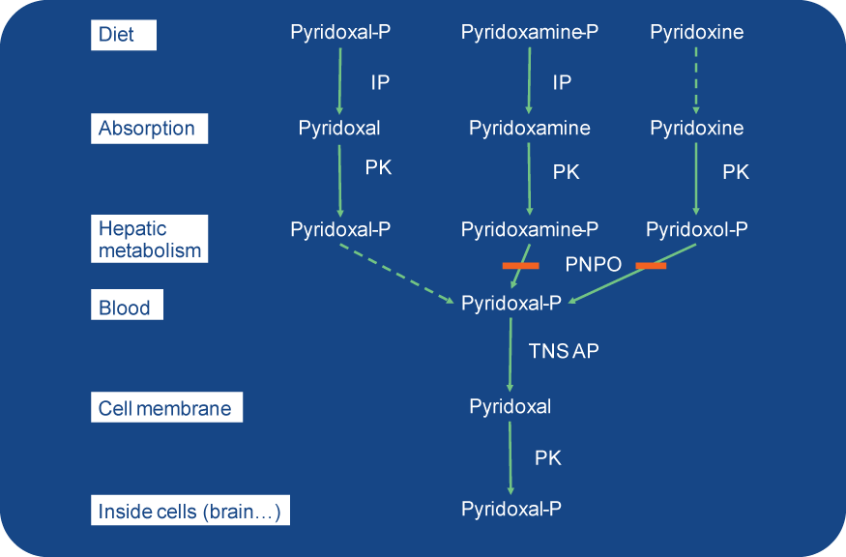
From Pearl PL. J Inherit Metab Dis 2009;32:204

Slide 10
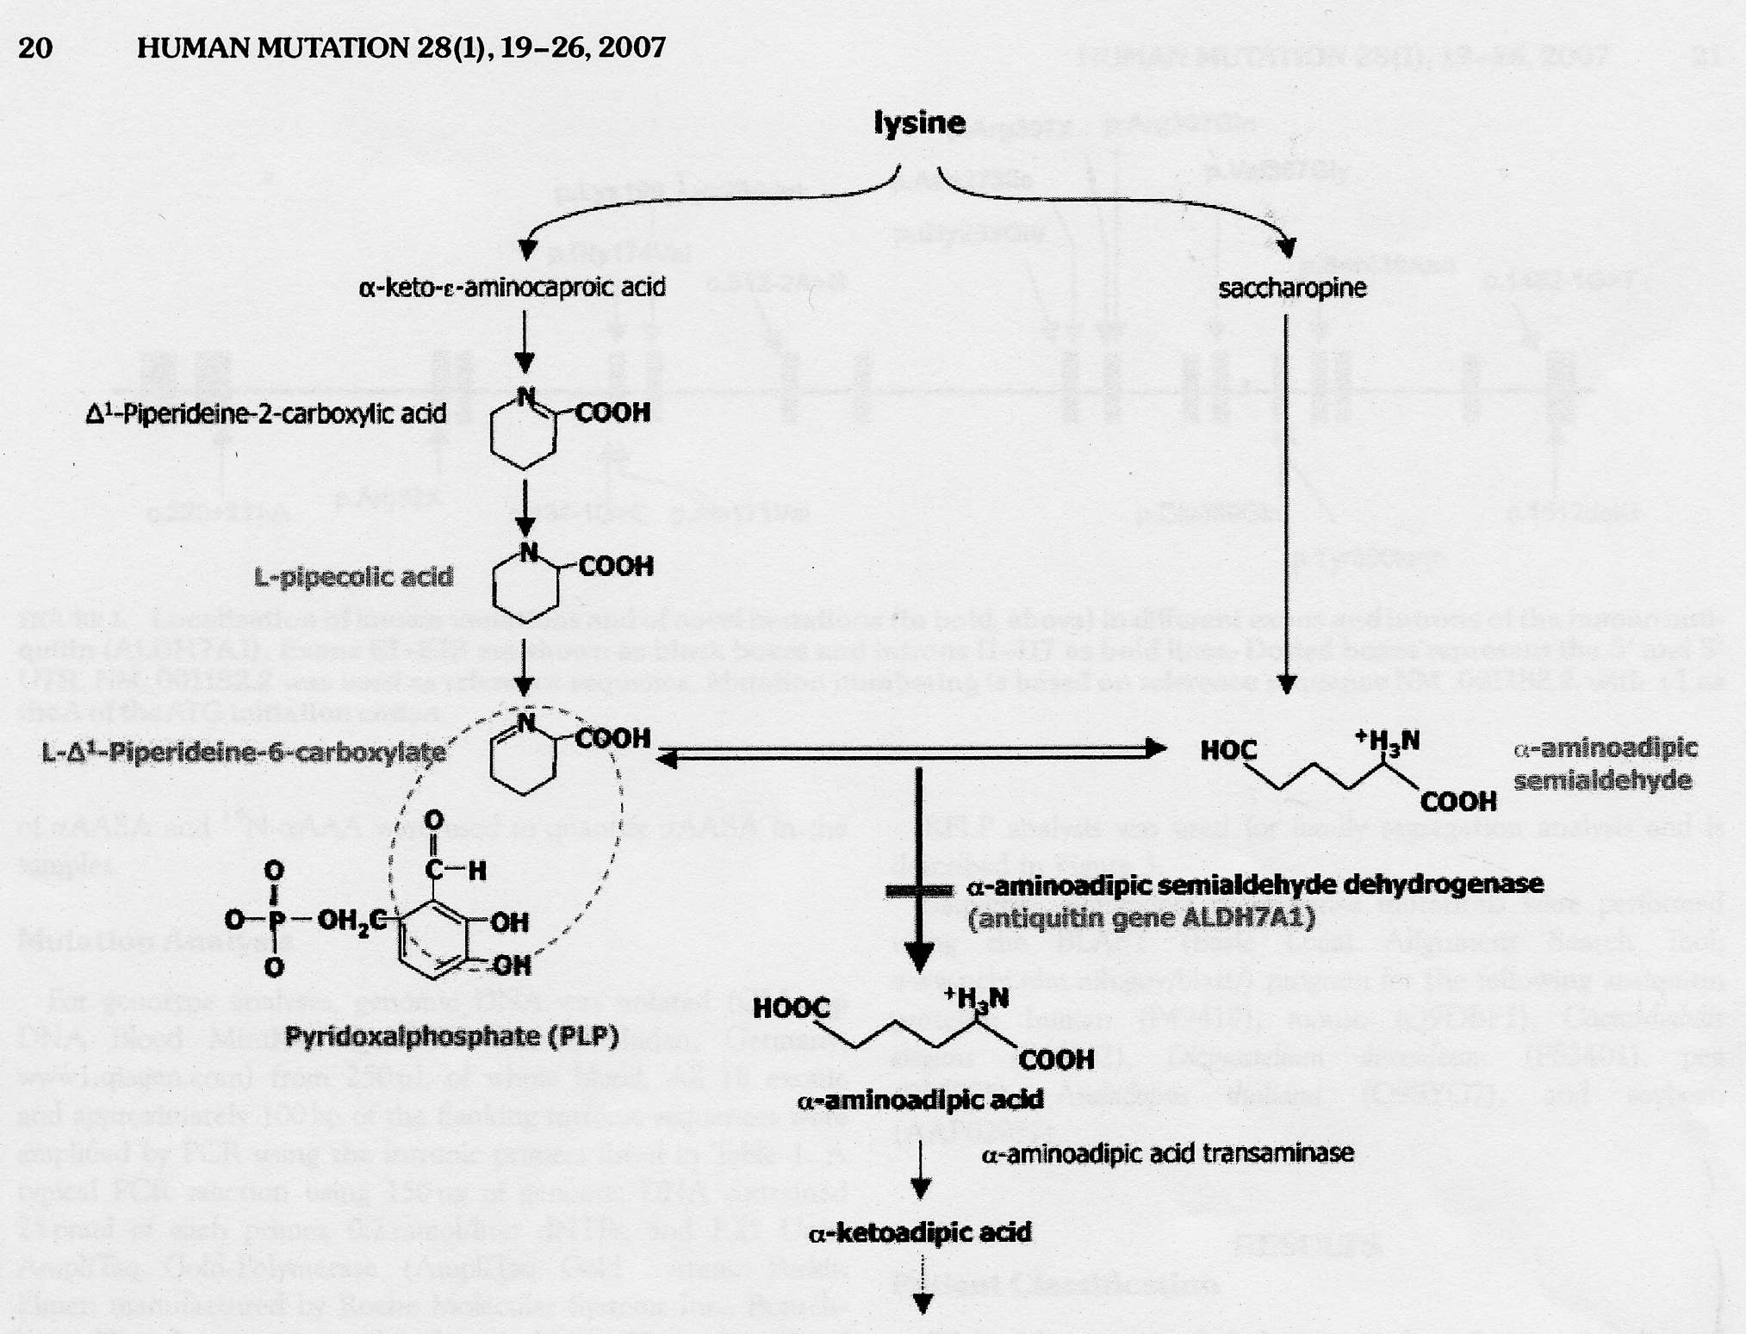
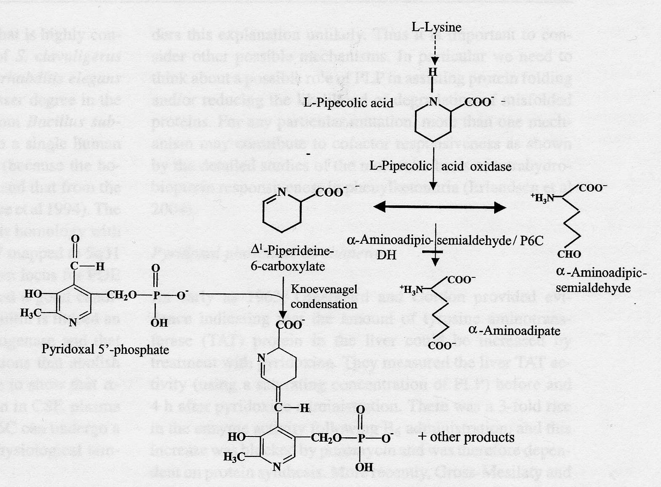
Pyridoxine-dependent epilepsy
Caused by a deficiency of α-aminoadipic semialdehyde
An enzyme in lysine oxidation
Accumulation of lysine-derived metabolites: α-AASA/Δ¹-P6C
Δ¹-P6C interacts with PLP
That reaction results in a secondary depletion of PLP
Not a primary disorder of B6 metabolism
Notes:
10

Slide 11
Pyridoxine-dependent epilepsy
Biochemistry:
α-aminoadipic semialdehyde dehydrogenase deficiency
Accumulation of α-aminoadipic semialdehyde, secondary elevation of pipecolic acid
Clinical presentation:
Seizures neonatal, early infantile, late-onset
Burst suppression, hypsarrhythmia, multifocal
Developmental delay, white matter abnormalities
Irritability, temperature instability
Outcome: most some developmental delay
Diagnosis: treatment trial 100 mg iv (q20min up to 500mg IV) under EEG, then pyridoxine 30 mg/kg/day for at least 3-5 days
α-aminoadipic semialdehyde in urine, (pipecolic acid in plasma)
Treatment: pyridoxine 30 mg/kg/day, monitor for neuropathy
Triple therapy: Lysine restricted diet and arginine (to competitively block lysine metabolism)
Notes:
11

Slide 12
PDE: Diagnosis
Positive clinical response to pyridoxine
Historical diagnostic “test” for PDE (30 mg/kg/d for 3 days)
20-25% of subjects have an immediate clinical response
Return of seizures upon withdrawal of pyridoxine - can be months!
High false negative results in a significant delay in diagnosis
Average diagnostic delay is 311 days
Elevated α-AASA/Δ¹-P6C (plasma, urine, CSF)
Metabolites are unstable and must be kept at -70⁰ C
Biallelic mutations in ALDH7A1
163 known/reported pathogenic variants
Population genetics (Coughlin): 1:64,000 births
Basura et al, Eur J Pediatr, 2009; Bok et al, Dev Med Child Neurol, 2012

Slide 13
PDE: Clinical findings
75-80% of subjects treated with pyridoxine alone have intellectual disability (ID)
The degree of ID does not correlate with clinical findings:
Age of seizure onset, seizure type or seizure control
Age at diagnosis
Biochemical findings
Basura et al, Eur J Pediatr, 2009;
Bok et al, Dev Med Child Neurol, 2012

Slide 14
PDE: Adjunct (to B6) treatment
Pyridoxine supplementation does not treat the underlying disorder of lysine oxidation
Lysine restriction therapies:
Lysine-restricted diet
Inhibition of lysine transport (arginine)
Combination of B6, lysine-restricted diet and arginine
van Karnebeek et al, Mol Genet Metab, 2012
Coughlin et al, Mol Genet Metab, 2015

Slide 15
PDE: Treatment
Pyridoxine: essential to treat epilepsy
Dose is age dependent ranging from 30 mg/kg/day (newborn) - 600 mg per day
Neuropathy risk at high doses
Lysine restriction treatment
A lysine (or protein) restricted diet
similar to GA1, perhaps stricter
Arginine supplementation (150-200 mg/kg/day)
Combination of dietary treatment and arginine (triple therapy)

Slide 16
PNPO deficiency: The other B6 related neonatal EE
Neonatal epileptic encephalopathy
75-80% of patients had onset of seizures in first 24 hours
Severe neurologic dysfunction that can be fatal
Rare, neurological and systemic symptoms:
Retinopathy (reversible)
Movement disorder
Normocytic anemia
Hyperphosphatasia
Biochemical features:
Increased glycine, threonine, decreased AADC
Guerriero et al, Ped Neurol, 2017;Mills et al, Brain, 2015

Slide 17
Pyridox(am)ine-5’-phosphate oxidase (PNPO) deficiency
Results from a deficiency of pyridoxal 5’-phosphate (PLP)
PLP is the active B6 vitamer
PNPO converts pyridoxine and pyroxamine to PLP
Therefore, most patients require PLP (and not pyridoxine) for treatment
Guerriero et al, Ped Neurol, 2017

Slide 18
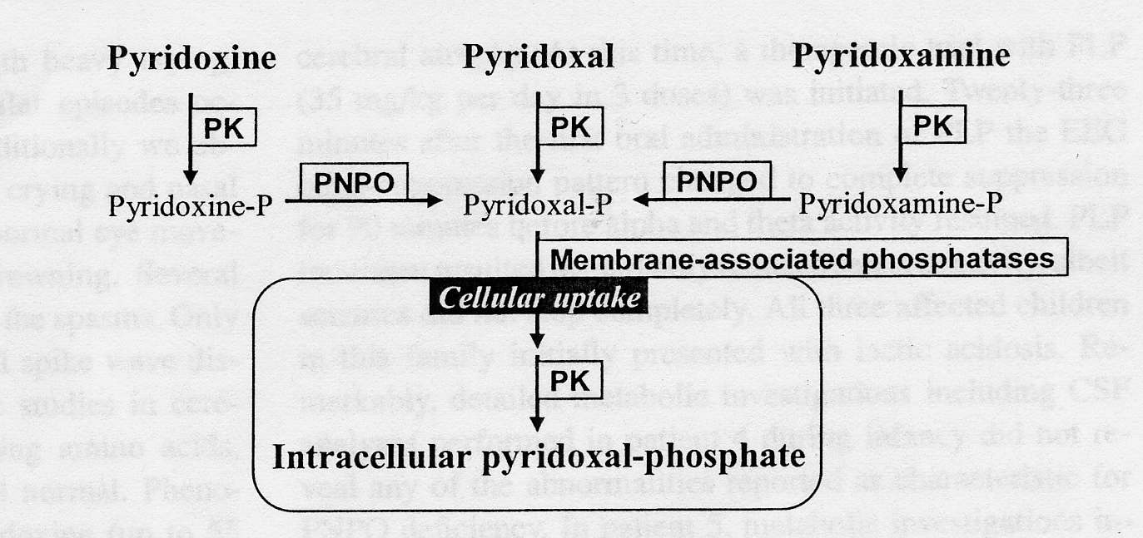
Pyridoxal-5’-phosphate deficiency / PNPO-related epileptic encephalopathy
Biochemistry: conversion of pyridoxine-P to pyridoxal-P
by pyrixod(am)ine phosphate oxidase deficiency (PNPO)
Clinical presentation
Premature, low Apgar scores
Neonatal seizures and encephalopathy: myoclonic, severe tonic-clonic
Burst suppression pattern
Outcome: good if treated early
Diagnosis: high threonine & glycine, low monoamine, low pyridoxal-P in CSF
Treatment: Pyridoxal-phosphate (not pyridoxine)
Note: Age and threonine in CSF
Neonate: 45-120
1 year: 20-45
Notes:
18

Slide 19
Glycine Encephalopathy (AKA NKH)
Characteristic feature: Elevated glycine levels in plasma and CSF
Early signs: Hypotonia, lethargy, seizures typically beginning in the neonatal period
Enzyme defect: Glycine cleavage system malfunction
Genetics: Mutations in GLDC, AMT, and GCSH genes
Treatment: Sodium benzoate to reduce glycine levels, NMDA receptor antagonists
Prognosis: Varies, most patients may have severe neurological impairment
Care considerations: Multidisciplinary approach to manage symptoms, supportive care

Slide 20
Glycine Encephalopathy
Deficiency in glycine cleavage enzyme (liver, brain, placenta)
Enzyme expressed in liver, brain and placenta
Accumulation of glycine in plasma and CSF
Increased CSF/plasma glycine ratio (diagnostic)

Slide 21
NKH =
deficient glycine cleavage enzyme activity
Serine
NFU1
ISC1
HSPAS9
HSCB
NH₃
SHMT
H₄-folate
CH₂=H₄folate
BOLA3
Glycine
IBA57
ISCA2
GSH
Lipoyl-E2
Fe-S
cluster
GLRX5
NH₂
T
AMT
PDH
KGDH
CH₂
LIPT1
SAM
S
SH
LIAS
H
GCSH
SH
SH
Lipoyl-H
Octanoyl-H
Apo-H
CO₂
LIPT2
P
GLDC
L
NAD
S
Octanoyl-mtACP
NH₂
Pyridoxal-P
S
CH₂
COOH
NADH + H⁺
mt FAS II
Variant NKH
Lipoate synthesis disorders
Classic NKH

Slide 22
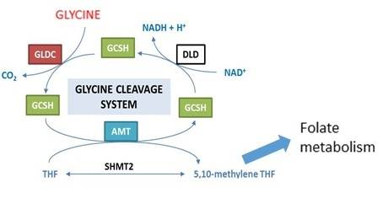
Glycine Cleavage Defect → Glycine Encephalopathy

Slide 23
GE/NKH types
Classic NKH:
Genes of GCE: P-protein (GLDC), T-protein (AMT)
According to severity
Severe : no – very little developmental progress, more seizures
Attenuated: makes developmental progress, less seizures
Variant NKH:
Other genes: lipoate synthesis defects, regulation (CblX)
Transient NKH: not genetic
transiently elevated CSF glycine
due to other brain disease IS NOT NKH

Slide 24
Severe NKH
Neonatal phase:
First three days: lethargy, poor drinking, into coma
No response to stimuli, including brain stem reflexes
Hypotonia pronounced, hiccupping, myoclonic spasms
Apnea (85%), may require ventilator support first 2-3 weeks
EEG: burst suppression pattern
Early Infancy:
All: resume breathing (D10-21)
Some but not all: improved contact, often drinking spontaneously
(classic NKH)

Slide 25
Severe NKH
Late infancy (3-12 months):
No or minimal developmental progress: only smile, coo or rolling over
Pyramidal tract signs (Babinski, hyperreflexia, spasticity)
Increasing seizures, increasing antiepileptic medications (therapy resistant)
EEG: hypsarrhythmia, then multifocal epilepsy
Cortical blindness
Feeding: usually by tube feeding
Late: scoliosis, poor feeding status, respiratory compromise (need secretion management)
(classic NKH)

Slide 26
Attenuated NKH
Mild or no pyramidal tract signs
Seizures:
None, or treatable with benzoate/dextromethorphan
Can require one or two anticonvulsants - treatable
Hyperactivity!, chorea and ataxia can also be present
Episodic lethargy, usually with infections
Severe adverse reaction to valproate, sometimes with vigabatrin
Presentation:
neonatal period (50%) (resemble severe NKH)
Infancy: first months; if later: attenuated good
Presentation: Hypotonia, lethargy, coma, seizures (treatable)
Variable developmental progress
Learn to grasp, sit, walk, communicate
Good phenotype: DQ 50-80, mainly hyperactive/behavioral issues
Intermediate: DQ 20-50, hyperactive, chorea, poor speech, seizures
Poor phenotype: DQ <20, seizures, autistic, absent speech
Mildest case: only ADHD

Slide 27
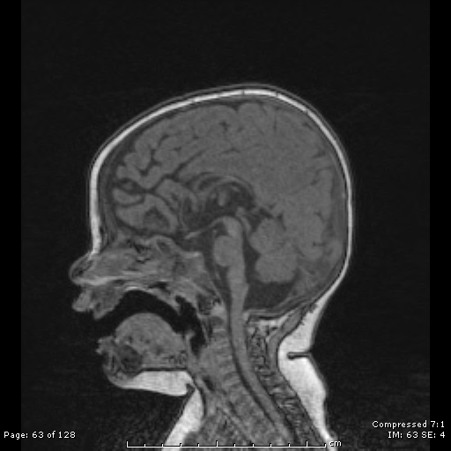
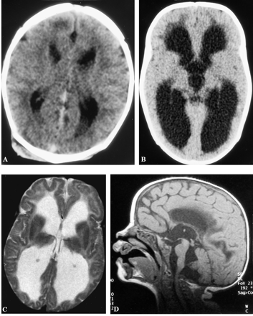
NKH Radiology
Corpus callosum: hypoplastic
Retrocerebellar cystic area with hydrocephalus

Slide 28
SEVERE NKH
Age 3.5 yrs
Small corpus callosum
Generalized atrophy
Persistent pattern of diffusion restriction

Slide 29
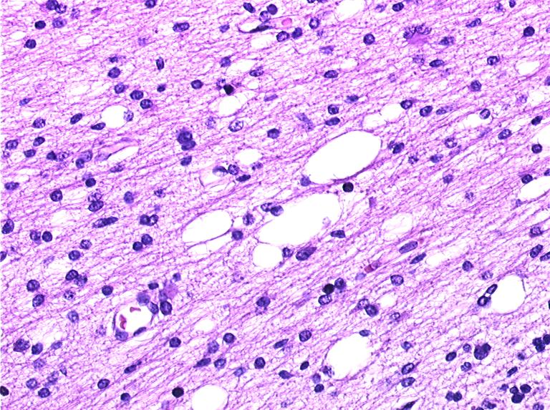
The brain and NKH: pathology
Neonates:
Normal amount of myelin
Microcystic vacuolation in myelin, variable sizes (spongiosis)
Cerebellar white matter, corticospinal tract, optic tracts and optic nerves
Splitting of myelin lamellae at extracellular space, outer side of myelin
Older:
Decrease in white matter, myelin volume
Spongiosis: all cerebral white matter (less subcortical)
Mild diffuse gliosis
Loss of cerebellar Purkinje cells
Cerebellar atrophy, cerebral atrophy
Cerebellar spongiosis
Mega-astrocyte

Slide 30
Biochemistry = Gold Standard
Glycine is high
Elevated glycine in blood (not specific!)
Elevated CSF glycine = primary diagnostic indicator!
Age dependent
Very rarely normal in mild NKH
Only reliable if no elevation of CSF protein
Elevated CSF:plasma glycine ratio – secondary parameter
Normal ≤ 0.02 ; affected ≥ 0.08; 0.02-0.06 in attenuated/variant NKH
Only reliable if 1. CSF glycine is elevated 2. sampling at same time

Slide 31
CSF glycine related to outcome DQ
Cutoff at 230 µM

Slide 32
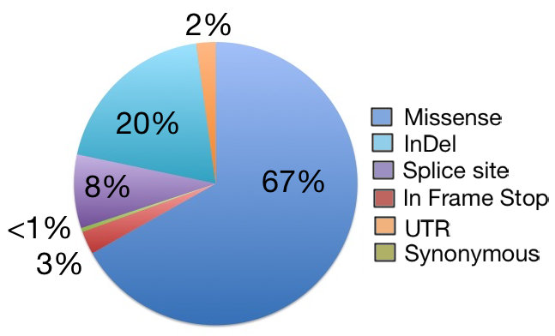
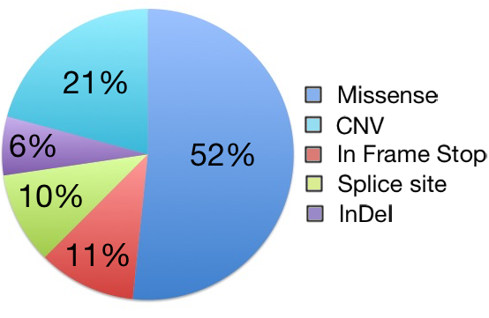
Classic NKH: GLDC and AMT Variants
In 562 unique families, sequencing and copy number variant analysis identified bi-allelic mutations in 550 cases.
-There was a 98% detection rate of pathogenic mutations - 410 unique mutations were identified: extensive intragenic allelic heterogeneity
80% GLDC 20% AMT

Slide 33
Mutant alleles with residual activity and disease severity
Developmental outcome
Epilepsy severity

Slide 34
Role of genotype
Genetics is important
Number of good mutations relates to outcome
Two bad mutations: severe outcome
One good mutation: chance of attenuated outcome
Permissive effect
Genetics is not everything
Poor relation of residual activity to outcome
Same genetics: different outcome
Modifying factors are important
Notes:
Of

Slide 35
Current treatment
Principle: Excess glycine overstimulates NMDA receptors: reduce glycine and block receptor
REDUCE GLYCINE: BENZOATE and DIET:
Benzoate:
Benzoate → benzoyl-CoA + glycine → hippurate → urine excretion
Starting dose: Attenuated: 300 mg/kg/d; Severe: 500 mg/kg/d; Treatment goal: plasma glycine 120 – 300 µM
Diet: Glycine in food is low, Dietary restriction for difficult to control severe NKH
BLOCK NMDA RECEPTORS:
Glycine is activator on NMDA receptor: overstimulation → use receptor blockers
DEXTROMETHORPHAN : Uncompetitive NMDA receptor antagonist (other receptors as well)
Dosing: 3-10 mg/kg/day (range 1 – 35)
KETAMINE

Slide 36
Glycine endogenous
synthesis
including protein catabolism, SHMT
Food
glycine + serine
SHMT
?constant
IN
Plasma glycine
in balance (normal levels)
Glycine endogenous use
OUT
OUT
Glycine cleavage enzyme
Benzoate
Urinary hippurate excretion
Neurologic outcome ?

Slide 37
Pathophysiology: Neurotransmitter disorder
Glycine inhibitory neurotransmitter in spinal cord (inhibition by strychnine) -- relation to hypotonia and apnea?
Strychnine: increased tone and respiration, but no consistent clinical effect on mental outcome
Glycine allosteric activator of NMDA receptor: excitatory
Other neurotransmitters normal
Na⁺
Ca⁺⁺
Glutamate
+
Dextromethorphan
Glycine
+
Mg⁺⁺
K⁺

Slide 38
Treatment effect
Severe patients:
Limited efficacy: more alert, breathing, easier seizure control
Developmental level: not affected
Attenuated patients: accumulating evidence of real efficacy
Benzoate: stabilization from episodes of CNS depression
Dextromethorphan (dose high enough 10 mg/kg/day for infant, 3 for older)
restore school functionality, resolve severe lethargy and severe chorea
Impact on cognitive outcome of benzoate+DMP/ketamine:
Effect depends on: mutation severity – timing: developmental window
sibling study- same genes:
First: treated late, suboptimal; Second: treated neonatal period, optimal
early treatment higher DQ, less epilepsy, better outcome

Slide 39
Early treatment in attenuated NKH
Bjoraker et al, J Peds, 2015

Slide 40
Sulfite oxidase and molybdenum cofactor

Slide 41
Molybdenum Cofactor Deficiency (MoCD)
Early presentation: Severe neonatal seizures, poor feeding, tachypnea
Characteristic findings: High levels of sulfite, xanthine, and uric acid in urine
Enzyme deficiency: Inability to synthesize molybdenum cofactor affecting several enzymes
Genetics: Mutations in genes MOCS1, MOCS2, and GPHN
Treatment: Cyclic pyranopterin monophosphate (cPMP) as a substitute
Prognosis: Without treatment, progressive neurological damage leading to early death
Recent developments: New therapeutic approaches under investigation

Slide 42
Sulfite oxidase deficiency
Seizures, severe mental retardation
Subcortical cystic encephalopathy
Later: lens dislocation
Lactic acidosis 50% of cases (pseudo-asphyxia)
Isolated sulfite oxidase (sulfite test strip – urine sulfocysteine)
Combined Mb cofactor: uric acid low (< 1mg/dl)

Slide 43
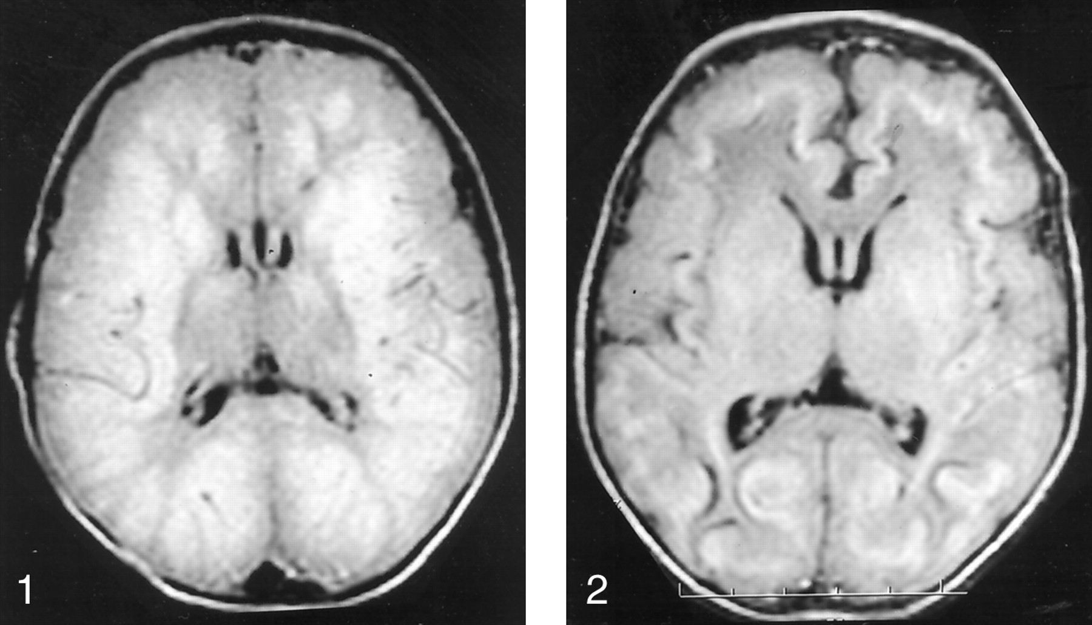

Axial MR image (TR/TE, 10,002/142) obtained when the patient was aged 5 days shows extensive areas of abnormal signal intensity, which suggest edema involving the bilateral cerebral white matter and bilateral parietal and occipital gray matter.
Arthur B. Dublin et al. AJNR Am J Neuroradiol 2002;23:484-485
©2002 by American Society of Neuroradiology
Notes:
Axial MR image (TR/TE, 10,002/142) obtained when the patient was aged 5 days shows extensive areas of abnormal signal intensity, which suggest edema involving the bilateral cerebral white matter and bilateral parietal and occipital gray matter. The bilateral frontal and temporal cortex, as well as parts of the basal ganglia, are probably spared. Ventricular size is normal.

Slide 44
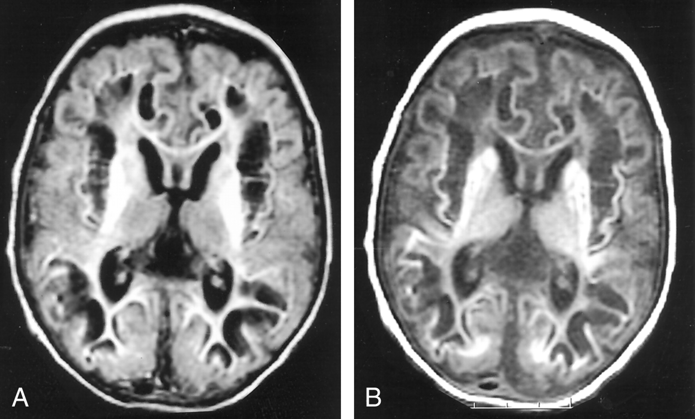
Axial MR images obtained when the patient was aged 31 days demonstrate dramatic changes compared with findings on initial images.
Arthur B. Dublin et al. AJNR Am J Neuroradiol 2002;23:484-485
©2002 by American Society of Neuroradiology
Notes:
Axial MR images obtained when the patient was aged 31 days demonstrate dramatic changes compared with findings on initial images. Extensive new cystic cavities are within the bilateral parietal, frontal, and temporal lobes and are medial to the insular cortex in both hemispheres. While global thinning of the cerebral cortex is present, this atrophy is most marked in the subinsular and parietal regions. Abnormal signal intensity is present within the bilateral basal ganglia, including the caudate, globus pallidus, and putamen, internal capsules, and centrum semiovale. Enlargement of ventricles and sulci is consistent with neuronal loss.A, TR/TE, 10,002/147.B, TR/TE, 516/8.

Slide 45
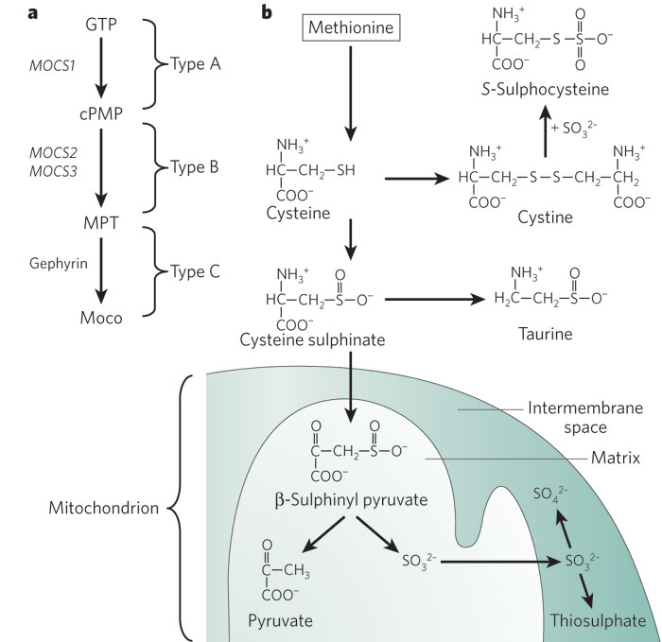
Pathways
GTP
MbCo
Hypoxanthine
Xanthine
Uric acid
MbCo
MbCo

Slide 46
Cysteine metabolism

Slide 47
Treatment
No effective treatment for severe sulfite oxidase deficiency
Mild sulfite oxidase deficiency: sulfur reduced diet
MoCo deficiency:
Type A = deficiency of pyranopterin synthesis (GTP to cyclic pyranopterin monophosphate pCMP)
Give pCMP, clear benefit in metabolites and clinically, best when started in the first week of life
Type B or C: no treatment

Slide 48
Mitochondrial Diseases + Epilepsy
GENC 6140
April 10, 2020
Austin Larson, MD

Slide 49
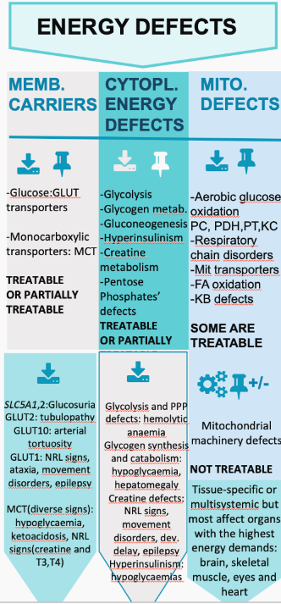
GENC 6140
April 10, 2020
Austin Larson, MD

Slide 50
Things to consider when thinking about mito disease
Is this mtDNA mediated or nuclear DNA mediated?
Which other family members might be affected?
How might their symptoms differ from the proband?
Am I thinking about a descriptive clinical syndrome or a specific genetic etiology?
In which tissues might I expect to find diagnostic results?
Is this a condition with a specific treatment? Or just more general mitochondrial considerations?
How much phenotyping do I need to do before obtaining genetic testing?

Slide 51
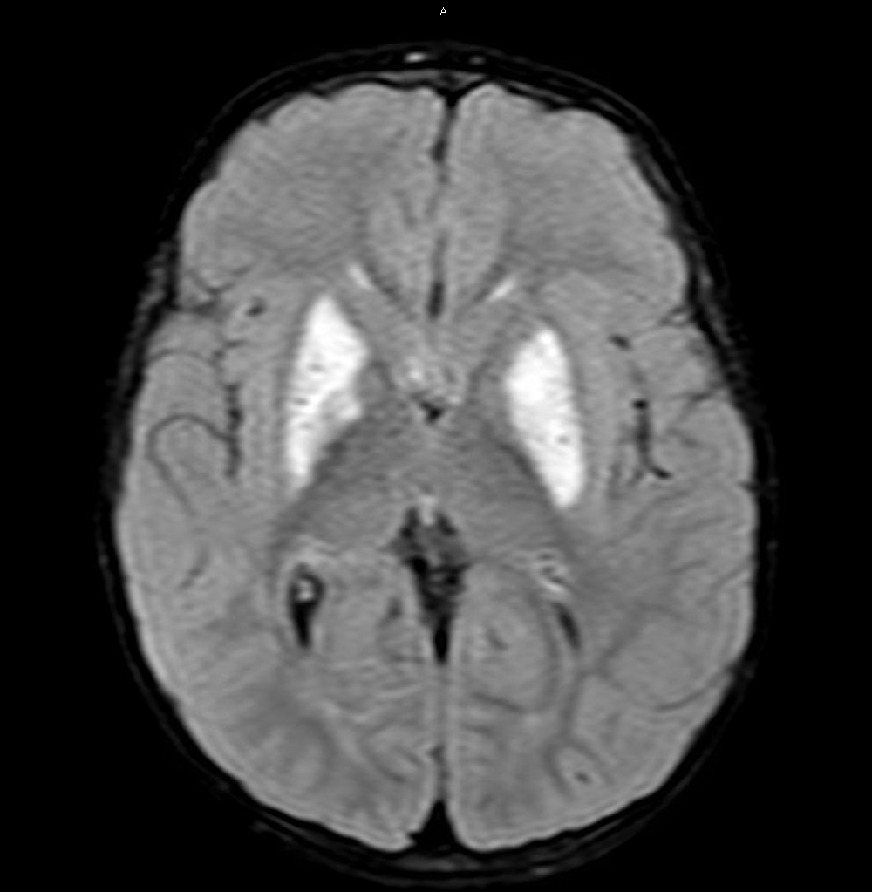
Leigh syndrome
A clinical description of a patient with:
developmental delay or neurological regression,
typical findings on brain MRI
Genetic or biochemical evidence of mitochondrial disease
At least 75 different genetic etiologies both nuclear and mtDNA
Typically with onset in early childhood and progression

Slide 52
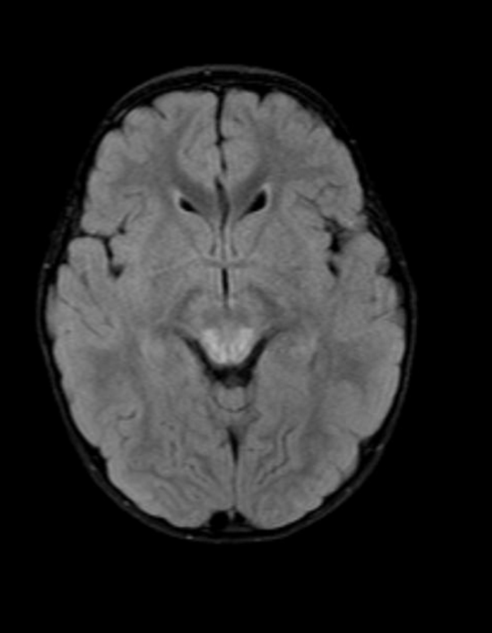
Leigh-like MRI appearance
Symmetrical high T2 signal in energy-intensive regions:
Brainstem
Periaqueductal gray
Medulla
Midbrain
Basal ganglia
Dentate nuclei
MRI can help to guide management
MRS, if available, may show elevated lactate

Slide 53
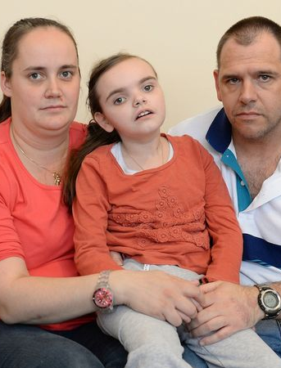
LS Clinical Features
Typical onset in the first 2 years of life (rarely up to adulthood)
Progressive and fatal disease, but sometimes very slow progression (especially if late-onset)
Neurological symptoms - developmental delay, hypotonia, dystonia, ataxia, seizures, hyperreflexia, apnea, dysphagia
Ocular symptoms - ptosis, ophthalmoplegia, optic atrophy
Regression with infectious illnesses
Mirror.co.uk

Slide 54
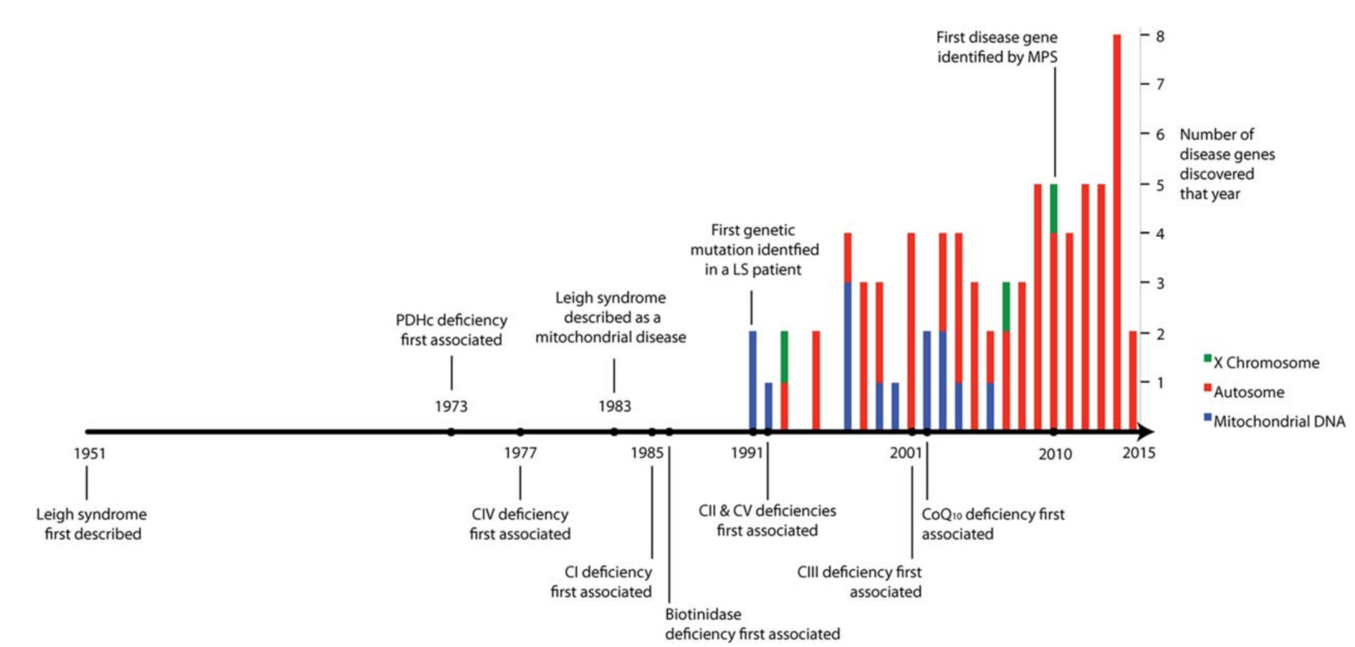
Known genetic etiologies of Leigh Syndrome
Lake et al Ann Neurol 2015

Slide 55
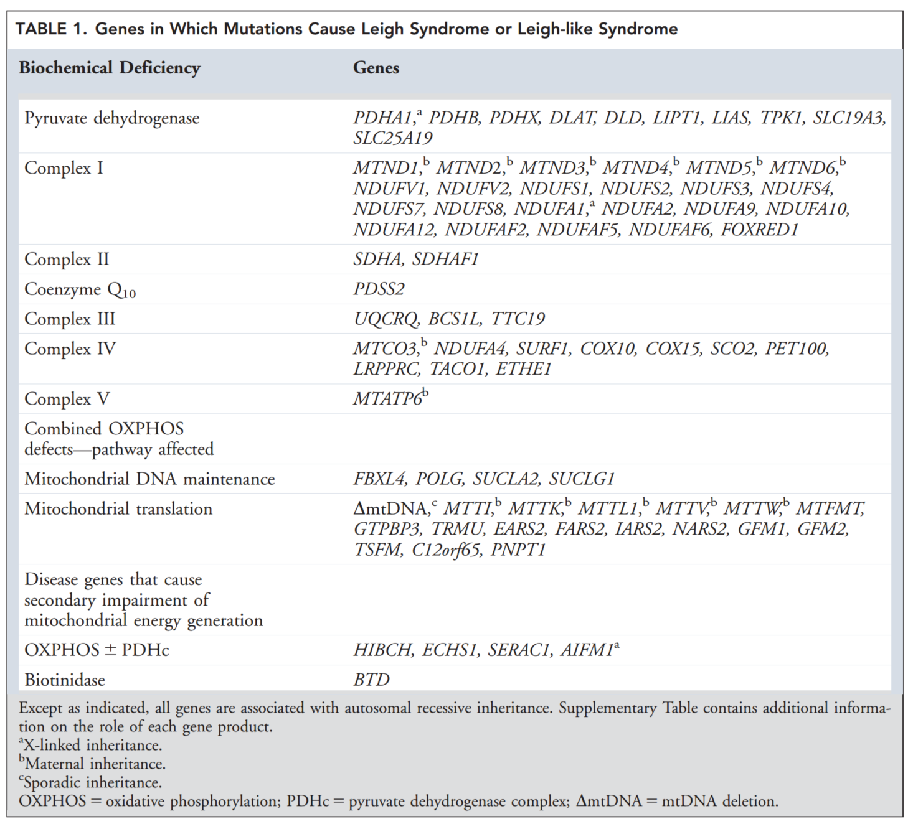
Lake et al Ann Neurol 2015

Slide 56
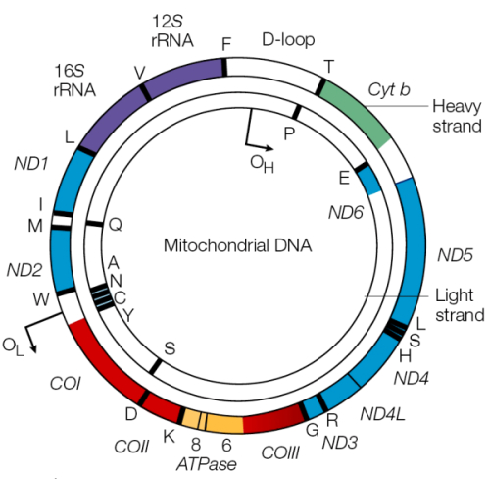
mtDNA
mutations

Slide 57
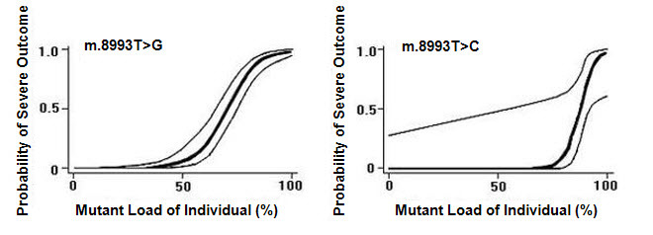
8993 mutations (ATP6)
For the more common T>G mutation:
High heteroplasmy may cause Leigh syndrome
Low heteroplasmy - likely asymptomatic
Moderate heteroplasmy may cause NARP
The T>C mutation is less likely to cause disease at a given level of heteroplasmy
This mutation has the best characterized heteroplasmy-phenotype correlation of any mtDNA mutation
White et al AJHG 1999

Slide 58
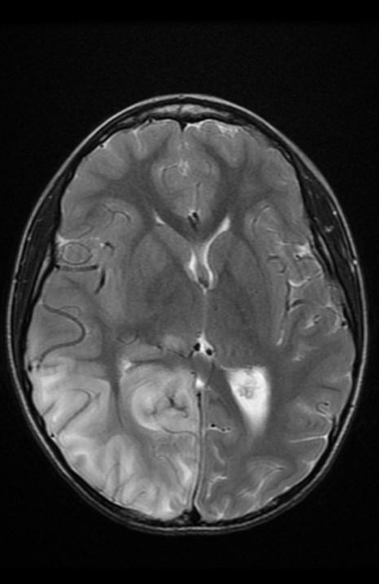
MELAS - presentation
Mitochondrial encephalomyopathy, lactic acidosis and stroke like episodes
80% of patients have m.3243A>G in tRNA Leu
Typical onset in childhood w/ normal early development → headaches, poor weight gain, short stature, exercise intolerance & weakness
Seizures, hearing loss
Cardiomyopathy and arrhythmia
Diabetes, renal disease
Stroke like episodes - transient hemiparesis, vision loss (only 15% in childhood)

Slide 59
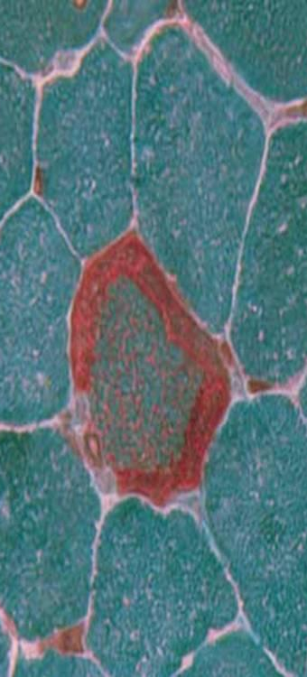
MELAS - testing and evaluation
3243 mutation may be at low levels in blood but higher in muscle or other tissue; this is age-dependent
Muscle biopsy with ragged red fibers
ETC enzymology with I, III and IV deficiency
CSF and blood with elevated lactate and alanine
CSF with elevated protein
MRI (or CT) with basal ganglia calcifications, white matter changes
EKG/Echo with cardiomyopathy

Slide 60
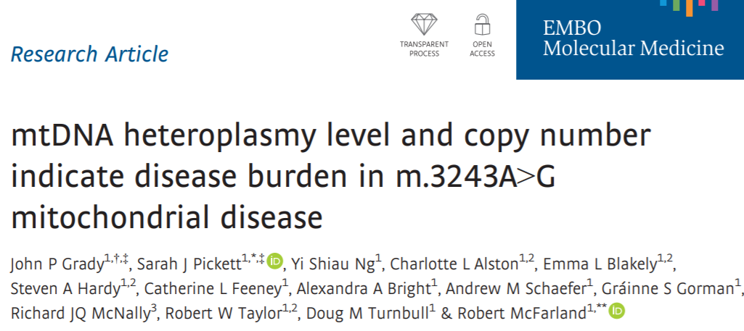
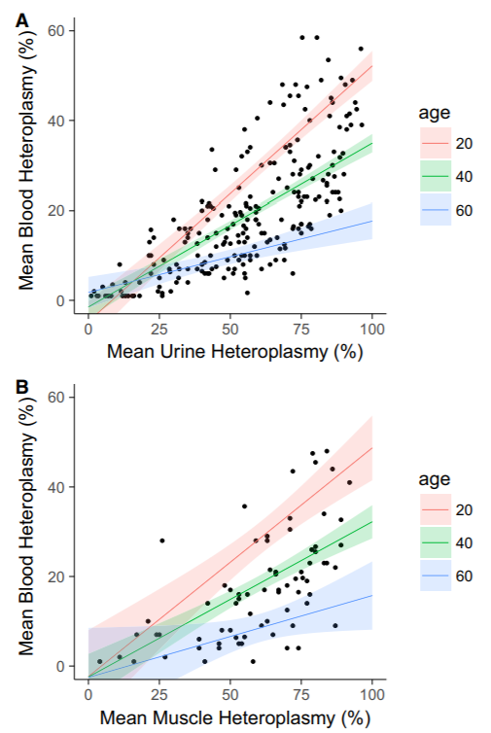
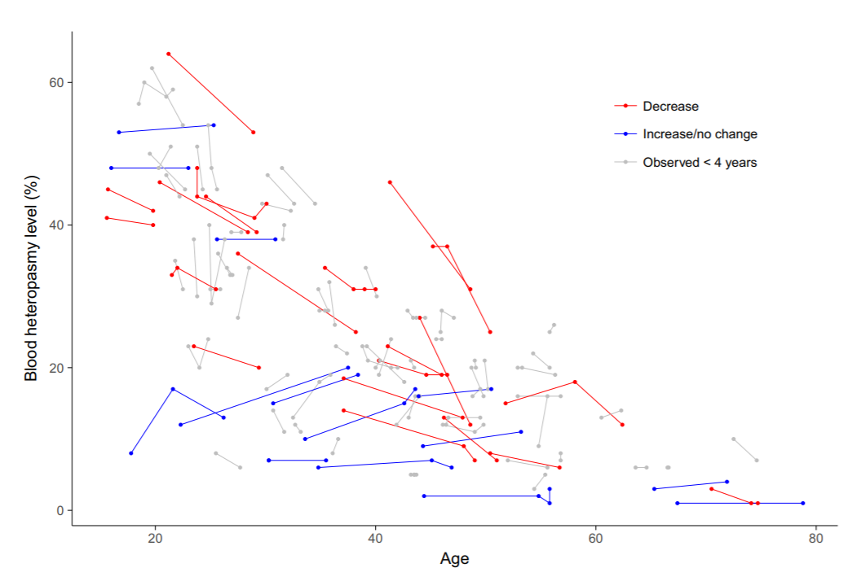

Slide 61
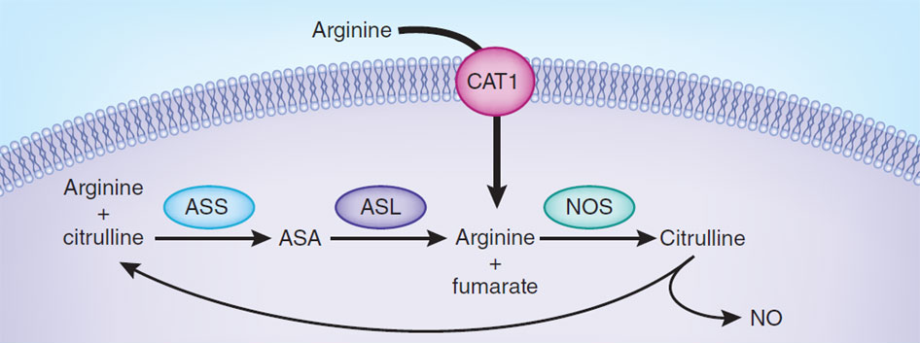
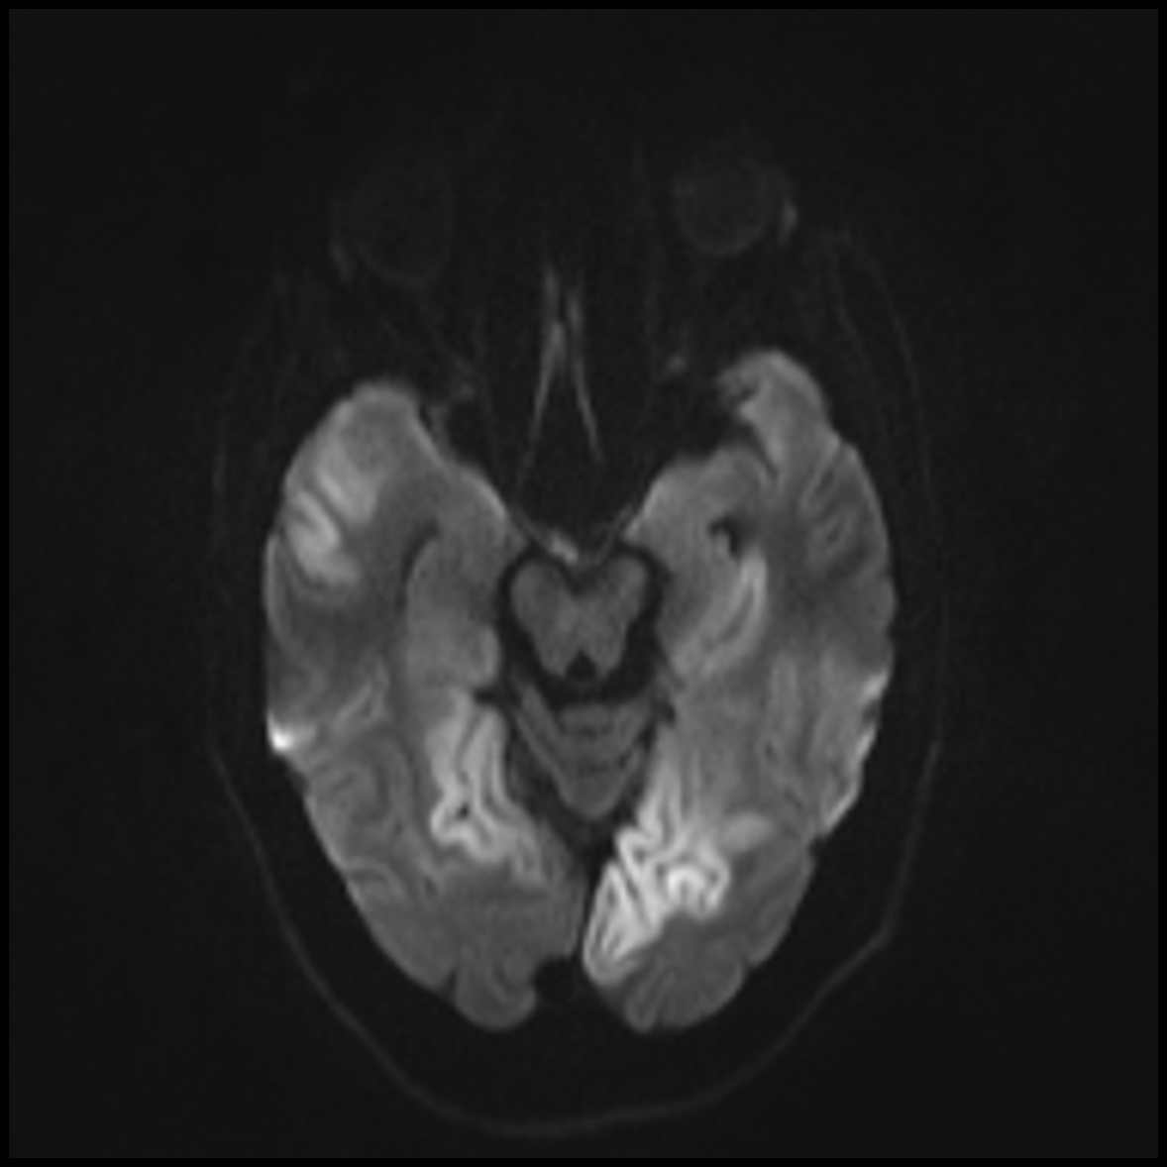
MELAS - treatment
Patients with MELAS have low arginine in serum
Arginine and citrulline participate in the NO cycle
NO production is responsible for vasodilation
Stroke-like episodes in MELAS are due to vasoconstriction
Treating with arginine or citrulline can reduce the severity of stroke like episodes
Gladwin et al Nat Med 2011

Slide 62
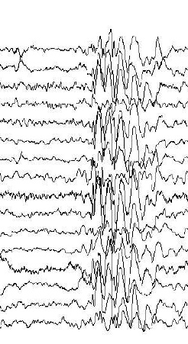
MERRF
Myoclonic epilepsy with ragged red fibers
80% of patients have m.8344A>G in tRNA Lys
Like MELAS, this is a mitochondrial translational defect
There are many overlapping features of the two disorders
MERRF - more likely to have myoclonus and seizures, lipomas
MELAS - more likely to have stroke-like episodes, migraines, diabetes, cardiomyopathy, renal disease
Some w/ m.8344A>G have a clinical dx of MELAS

Slide 63
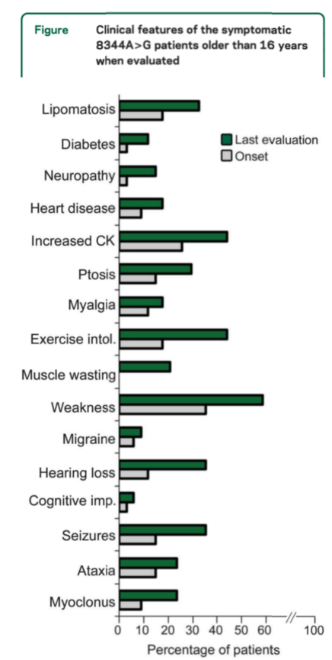
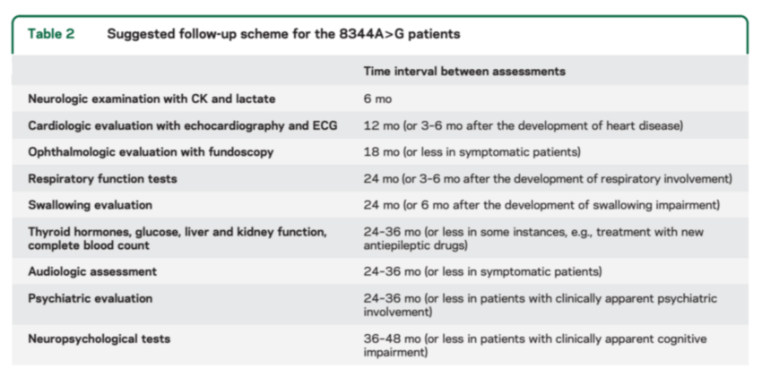
MERRF: Clinical features & management
Mancuso et al Neurology 2013

Slide 64

MERRF - heteroplasmy
Lipoma in a patient with MERRF
Average heteroplasmy of symptomatic individuals -
67% in muscle
57% in blood
59% in urine
Average heteroplasmy in asymptomatic relatives that were tested:
57% in blood
Ncorrelation between heteroplasmy in blood & in other tissue
No correlation between heteroplasmy and age of onset
Mean age of onset in this cohort of 39 patients was 30 years
Mancuso et al Neurology 2013
Chandra et al JPGM 2015

Slide 65
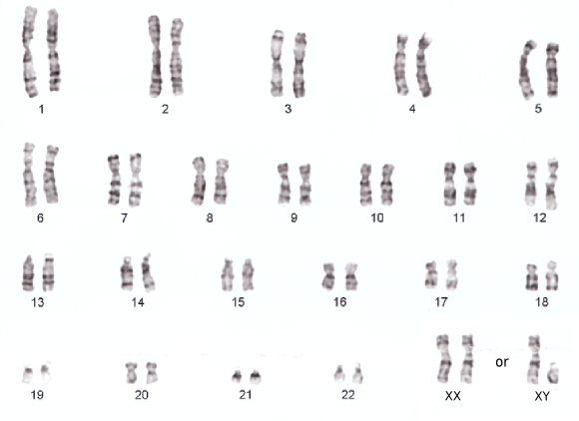
Nuclear
DNA
mutations

Slide 66
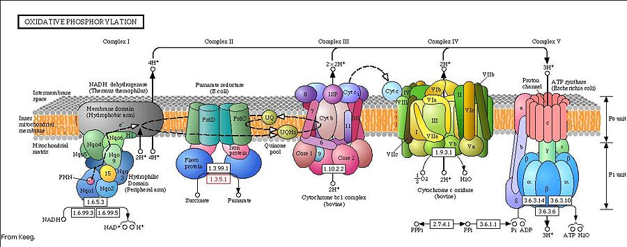
Nuclear encoded respiratory
chain complex proteins

Slide 67
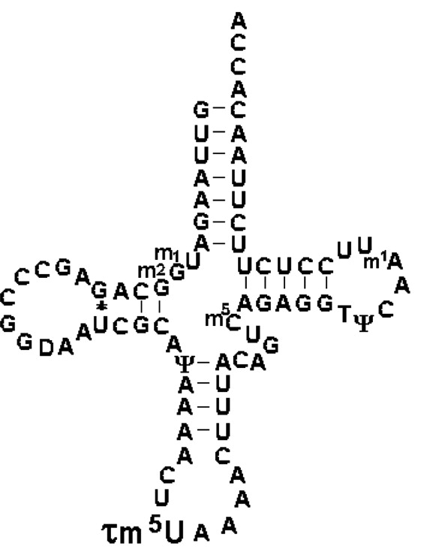
Mitochondrial translational defects
Kirino PNAS 2004

Slide 68
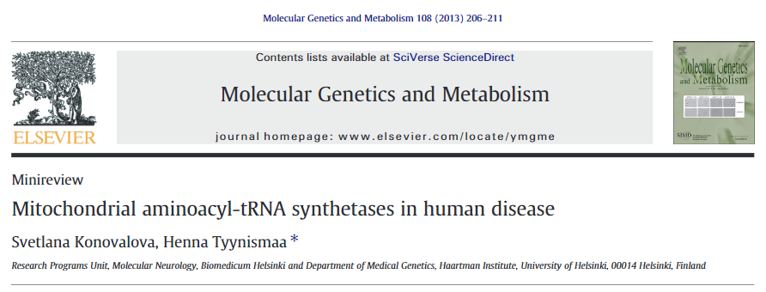
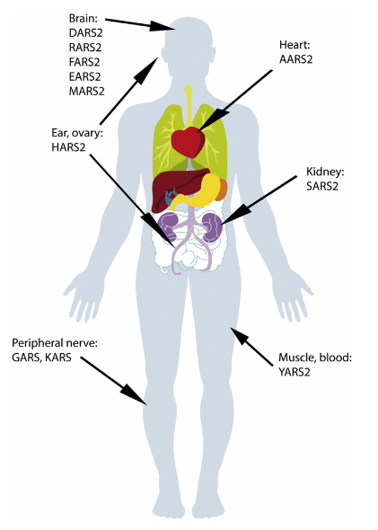
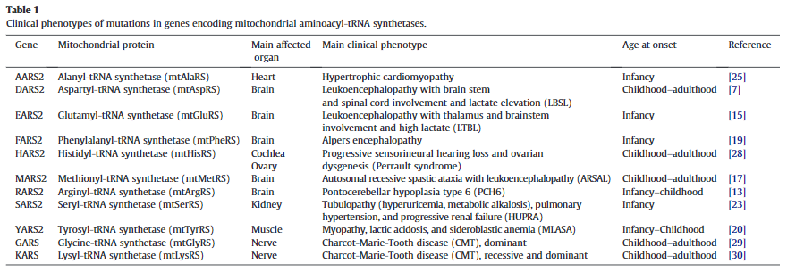

Slide 69
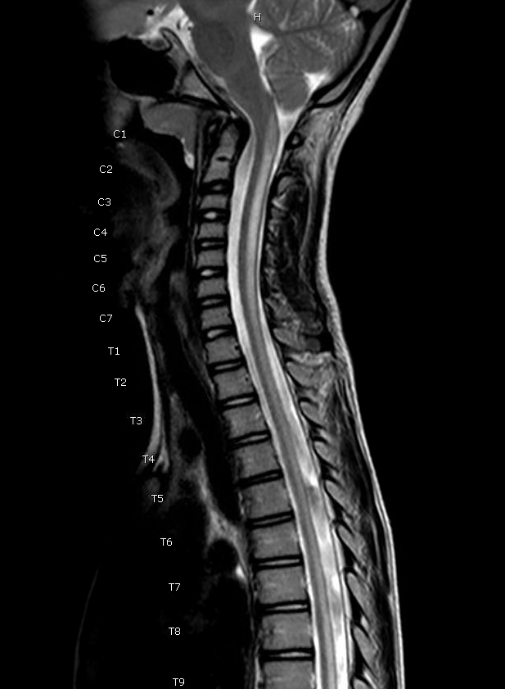
DARS2 - LBSL
DARS2 = aspartyl-tRNA synthase
Leukoencephalopathy with brainstem and spinal cord involvement and elevated lactate
Childhood onset, very slowly progressive ataxia and spasticity
Loss of ambulation in early adulthood
Characteristic MRI findings - T2 hyperintensity of the spinal cord as well as of the cerebral white matter

Slide 70
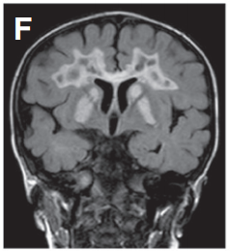
MTFMT - Leigh
Mitochondrial methionyl-tRNA formyltransferase
The initiating methionine in an mtDNA-encoded protein is formylated
One of the most common causes of Leigh disease
Later onset and slower progression than most Leigh; rarely with acute regression
Microcephaly, weakness, ataxia
Haack Mol Genet Metab 2014

Slide 71
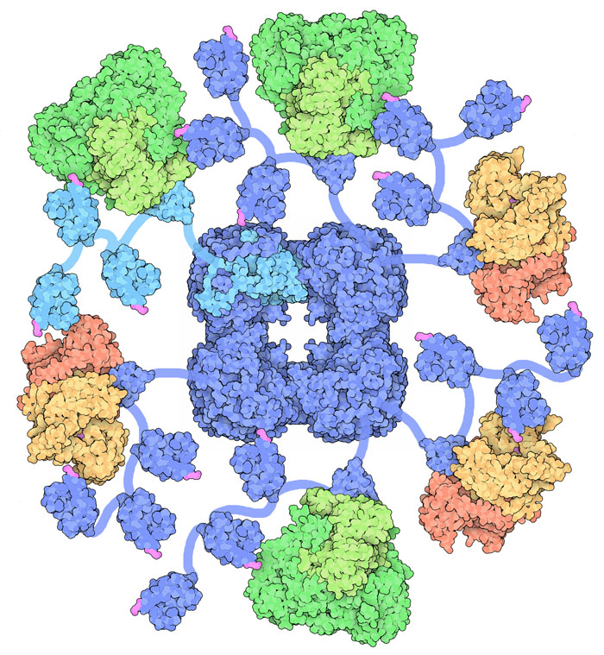
Pyruvate dehydrogenase
Protein Data Bank

Slide 72
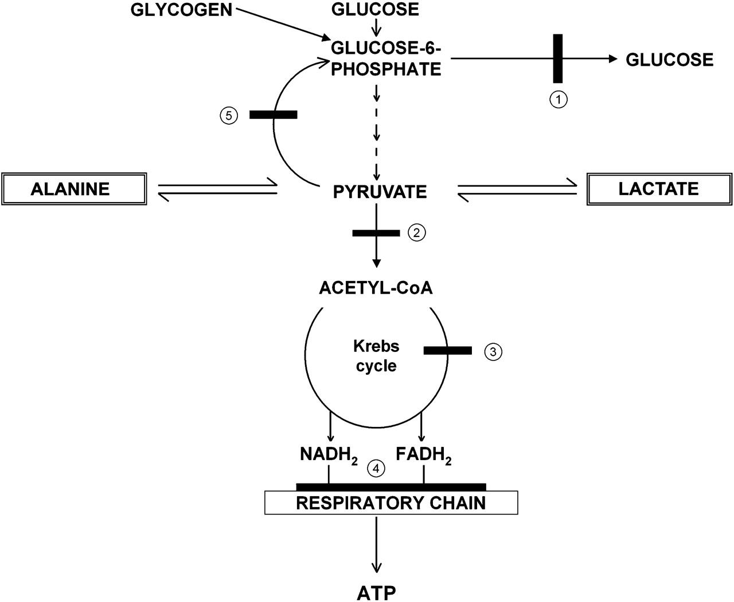
Pyruvate Dehydrogenase Deficiency (PDH)
PDH is a large multi-subunit enzyme complex in the mitochondrial matrix that links glycolysis with the TCA cycle
There are multiple primary and secondary genetic causes of PDH deficiency (~13 genes)
The most common is the X-linked gene PDHA1 (80% of patients)
Encodes the E1α subunit of the complex

Slide 73
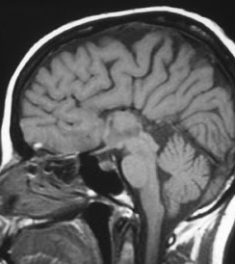
PDHA1 - girls
Girls present with severe GDD & brain malformations
Agenesis of the corpus callosum
Cystic lesions
General atrophy
Dysmorphic facial features
Unlikely to have significant elevation of lactic acid
Girls are mosaic for severe PDH deficiency due to X-inactivation in some tissues

Slide 74
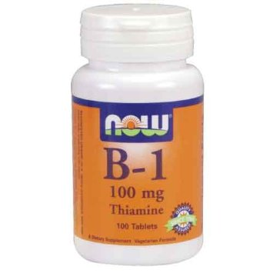

PDHA1 - Boys
Boys tend to have mild mutations (missense)
May present with ataxia, hypotonia, developmental delay
MRI with Leigh-like findings or cerebellar atrophy, not structural lesions
May have severely elevated lactate and pyruvate with low/normal ratio
Diagnostic testing - enzyme assay, sequencing
Treatment: thiamine and/or ketogenic diet
Dicholoroacetate (DCA) treats lactic acidosis but no clinical improvement (maybe)

Slide 75
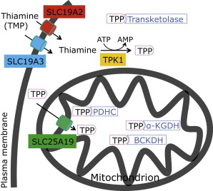
Thiamine disorders
Result in pyruvate dehydrogenase dysfunction as well as other enzymes
Leigh-like brain MRI findings or microcephaly
Cell membrane and mitochondrial membrane transporters
Thiamine phosphokinase
Some treatable with thiamine supplementation, but often diagnosed late in the course
Mayr et al AJHG 2011

Slide 76
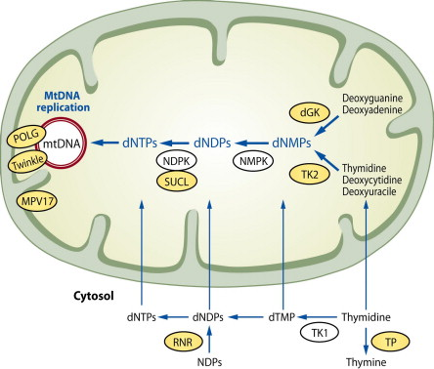
mtDNA maintenance
Suomalainen et al Neuromuscular Disorders 2010

Slide 77
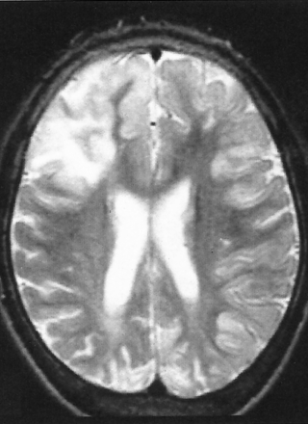
Alpers Syndrome
Caused by biallelic mutations in POLG
Normal early development (or mild delay)
First symptom is usually seizures in early childhood, often EPC
Seizures are often refractory to treatment
Valproic acid (seizure drug) may precipitate liver failure
Progressive and fatal within a few years
Diagnostic studies: characteristic MRI, complex I/III/IV deficiency, mtDNA depletion
Fleming et al AJNR 2002

Slide 78
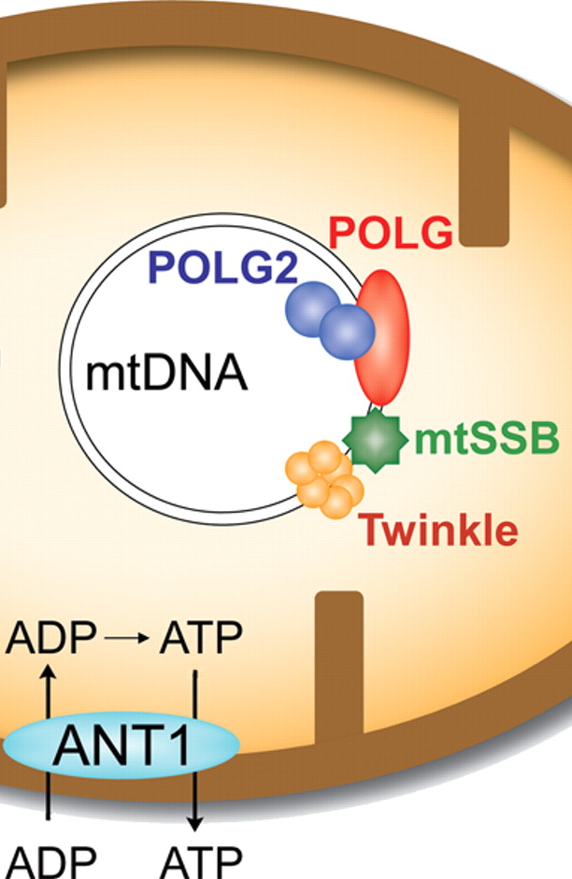
Other POLG presentations
Later onset POLG disease similar to POLG2 and twinkle (c10orf2) mutations
Overall, POLG is one of the most common causes of mitochondrial disease
Dominant or recessive disease
CPEO with:
Myopathy, neuropathy
Endocrinopathy (ovarian and testicular failure)
SANDO: Sensory ataxic neuropathy, dysarthria, ophthalmoparesis
Parkinsonism
Muscle biopsy with ragged red fibers, COX deficient fibers, multiple different mtDNA deletions
Milone et al
Neurology 2011

Slide 79
Other Energy Defect Disorders?

Slide 80
Glucose Transporter 1 Deficiency (Glut1 DS)
Infancy onset: Broad spectrum of seizure types
Diagnosis: Hypoglycorrhachia with normal blood glucose levels
Associated features: Developmental delay, movement disorders
Treatment: Ketogenic diet; cornstarch?
Genetics: Mutations in SLC2A1 gene
Spectrum: Includes paroxysmal exercise-induced dyskinesia, other paroxysmal neurologic symptoms
Neuroimaging: Typically normal; can show hypomyelination

Slide 81

Glut1 DS
From Santer R and Klepper J, in Saudubray JM, Inborn Metabolic Disease, 2014

Slide 82
Glut1 DS
From Santer R and Klepper J, in Saudubray JM, Inborn Metabolic Disease, 2014

Slide 83
GLUT1 deficiency
Normal prenatal, perinatal history
Infantile-onset encephalopathy with seizures (usually <2 yrs. age)
Acquired microcephaly
Variable cognitive impairment and complex motor disorder
Paroxysmal events
Intermittent ataxia
Choreoathetosis
Dystonia
Alternating hemiplegia
Symptoms precipitated by
Fasting
Intercurrent infection, especially with fever
Autosomal dominant (most commonly)
Notes:
GLUT1 is also highly expressed in erythrocytes, where 5% of the membrane proteins are GLUT1. This is an explanation why an exercise-induced energy deficit can be accompanied by hemolytic anemia, which may result from alterations in intracellular electrolytes caused by a cation leak through mutant GLUT1. Cerebral GLUT1 defects can be shown on erythrocytes.
Normal prenatal, perinatal history
Infantile-onset encephalopathy with seizures
Variable seizure types and frequency in first year of life
Often refractory to antiepileptics
Acquired microcephaly
Variable cognitive impairment and complex motor disorder
Paroxysmal events
Spasticity, intermittent ataxia, alternating hemiparesis
Confusion, lethargy, somnolence
Speech and language impairment

Slide 84
GLUT1DS Non-classical phenotypes
(NOTE – BG WILL BE NORMAL)
Movement disorder without seizures
Carbohydrate-responsiveness
Familial paroxysmal exercise-induced dystonia (PED)
Onset beyond childhood
Normal interictal neurologic exam
Hemolytic anemia
Neurologic symptoms
Notes:
Hyperammonemia caused by an increased rate of oxidative deamination of glutamate to alphaketoglutarate
Movement disorder without seizures: mild developmental delay, dysarthria, ataxia, choreoathetosis, dystonia, ± microcephaly
Carbohydrate-responsive
Familial paroxysmal exercise-induced dystonia (PED): involuntary dystonia, choreoathetosis, ballismus after prolonged exercise affecting the exercised limbs
Onset beyond childhood, with normal head circumference
Normal interictal neurologic exam
Hemolytic anemia, deformation of erythrocytes

Slide 85
Lab findings
Low CSF glucose level
<60 mg/dL (3.3 mM) in all cases
<40 mg/dL (2.2 mM) in >90%
40–60 mg/dL (2.2-3.3 mM) in ~10%
CSF:blood glucose ratio <0.5 (typically measure 4 hr fast)
CSF lactate low to low normal
Normal routine and metabolic labs
EEG may be normal when well
Molecular diagnostic testing will establish diagnosis
SLC2A1
Erythrocyte 3-O-methyl-D-glucose uptake
Notes:
Low CSF glucose level
Affected levels 0.9-2.9 mM
Higher in milder disease
CSF:blood glucose ratio <0.5
CSF lactate low to low normal
Normal routine and metabolic labs
EEG may be normal when well
Molecular testing will establish diagnosis
Autosomal dominant inheritance (rare autosomal recessive cases have been reported)
GLUT1DS may be confirmed by Western blot analysis and studies on glucose uptake into erythrocytes, cells abundantly expressing GLUT1. Glucose uptake and GLUT1 expression measured in erythrocytes are generally reduced to about half control values and do not correlate with disease severity.
Approximately 80% of patients are heterozygous for mutations within the GLUT1 (SLC2A1) gene located on chromosome 1p35-31.3. Mutations are mostly de novo, of various character (missense, nonsense, and splice-site mutations, haploinsufficiency, compound heterozygosity and paternal mosaicism) and randomly distributed. Emerging mutational hotspots have implications for GLUT1 function. The type of mutation and the extent of hypoglycorrhachia is related to the phenotype; missense mutations and higher CSF glucose concentrations appear to be associated with a milder clinical presentation

Slide 86
Treatment/Prognosis
Ketogenic diet provides an alternative fuel
Ketone bodies use different transporter (MCT1) to cross BBB, provide brain with only known alternative fuel for metabolism
Multivitamins plus calcium, carnitine
Alpha-lipoic acid (thioctic acid) has been shown to facilitate glucose transport in vitro
GLUT1 inhibitory drugs should be avoided
Prognosis: seizures and variable cognitive/motor impairment
Clinical trial with triheptanoin
Notes:
Ketogenic diet provides an alternative fuel
3:1-4:1 ratio of calories from fat:non-fat sources
Continue through adolescence
Multivitamins plus calcium
GLUT1 inhibitory drugs should be avoided
Anticonvulsives (phenobarb, chloral hydrate, diazepam)
Methylxanthines (theophyllin, caffeine)
Alcohol
Green tea
Prognosis: seizures and variable impairment
SLC45A1 deficiency (neuronal glucose transporter deficiency) that leads to intellectual developmental disorder with neuropsychiatric features.

Slide 87
Review of other Metabolic Epilepsies

Slide 88
Asparagine synthetase deficiency
Congenital microcephaly
Intellectual disability
Progressive cerebral atrophy
Intractable seizures
Autosomal recessive mutations in ASNS gene
Levels of aspartate and asparagine: normal in plasma and urine!!
No treatment described

Slide 89
Glutamine synthetase deficiency
Neonatal severe encephalopathy, neonatal seizures
Nearly complete agyria, paraventricular cysts, smooth cerebellum
Blistering erythematous rash
Very low glutamine in plasma and CSF, chronic moderate hyperammonemia
Supplementation with glutamine, up to 1020 mg/kg/day
Eeg improved, increase glutamine on MRS, plasma normalized but CSF still low
Secondary disturbance in NAD synthesis
Treat with nicotinamide

Slide 90
Biotin-Responsive Basal Ganglia Disease
Clinical presentation: Subacute encephalopathy triggered by stressors
Diagnostic clue: Bilateral basal ganglia involvement on MRI
Treatment: High doses of biotin and thiamine
Prognosis: Rapid improvement with treatment, potential for relapse
Genetics: Mutations in SLC19A3 gene
Pathophysiology: Thiamine transporter defect
Preventive aspect: Awareness critical for early treatment initiation

Slide 91
BH4 Deficiency
Intellectual disability, microcephaly, myoclonic seizures, muscular rigidity, dystonia
Neuroimaging may show cerebral atrophy and basal ganglia calcifications
Dietary management and specific supplementation for treatment

Slide 92
Creatine Transporter Deficiency
Symptoms: Intellectual disability, seizures, speech delay
Diagnosis: Elevated creatine/creatinine ratio in urine, confirmed by genetic testing
Treatment: No definitive treatment, management focuses on symptoms
Pathophysiology: Defective creatine transport into the brain
Genetics: X-linked disorder with mutations in SLC6A8 gene
Clinical management: Combination of physical, occupational, and speech therapy
Neuroimaging: Brain MRI may show delayed myelination

Slide 93
Phenylketonuria (PKU)
Newborn screening: Elevated phenylalanine levels
Dietary management: Lifelong low-phenylalanine diet necessary
Pathophysiology: Deficiency of phenylalanine hydroxylase (PAH)
Genetics: PAH gene mutations, multiple variants affecting severity
Neurological impact: Untreated PKU leads to intellectual disability, seizures
Treatment advances: Enzyme replacement and gene therapy in research
Monitoring: Regular blood tests to ensure dietary compliance and phenylalanine levels

Slide 94
Maple Syrup Urine Disease (MSUD)
Distinctive feature: Sweet-smelling urine, similar to maple syrup
Biochemical profile: Elevated levels of leucine, isoleucine, and valine in blood
Acute management: Rapid dietary intervention critical during metabolic crises
Chronic management: Lifelong dietary restriction of branched-chain amino acids
Genetics: Mutations in the BCKDHA, BCKDHB, DBT, and DLD genes
Neurological risks: Neurodegeneration if untreated or poorly managed
Long-term care: Regular monitoring and dietary adjustments necessary

Slide 95
Urea Cycle Disorders
Diverse presentation: Varies from neonatal hyperammonemia to late-onset episodic encephalopathy
Diagnostic markers: Elevated ammonia and specific amino acids depending on the enzyme defect
Management: Dietary protein restriction, nitrogen scavenging drugs
Genetic variability: Mutations in NAGS, CPS1, OTC, ASS1, ASL, ARG1, and CITRIN
Therapeutic developments: Liver transplant considered in severe cases
Family implications: Genetic counseling recommended due to inheritance patterns
Patient support: Importance of emergency protocols for hyperammonemic crises

Slide 96
Organic Acidemias
Common types: Propionic acidemia (PA), methylmalonic acidemia (MMA)
Initial symptoms: Poor feeding, vomiting, lethargy, and hypotonia
Metabolic derangement: Accumulation of toxic organic acids in blood
Genetic testing: Confirmatory for specific enzyme deficiencies
Therapies: Dietary management, vitamin supplementation, avoidance of catabolic stress
Neurological sequelae: Risk of basal ganglia stroke, developmental delay
Patient monitoring: Regular follow-up with metabolic specialists

Slide 97
Fatty Acid Oxidation Disorders
Clinical scenarios: Hypoglycemia with illness or fasting, rhabdomyolysis with exercise
Diagnostic tests: Acylcarnitine profile, urine organic acids, enzyme assays in fibroblasts
Preventive strategies: Avoidance of fasting, high-carbohydrate diet, medium-chain triglycerides (MCT) oil
Genetic spectrum: Mutations in genes encoding enzymes for fatty acid beta-oxidation
Emergency management: Aggressive treatment during metabolic decompensation
Family planning: Genetic counseling and possible prenatal diagnosis
Research horizon: Novel therapies including gene therapy are being explored

Slide 98
Disorders of GABA Metabolism
Examples: GABA-transaminase deficiency, succinic semialdehyde dehydrogenase (SSADH) deficiency
Clinical spectrum: Developmental delay, seizures, hypotonia
Biochemical profile: Elevated GABA and GHB in biological fluids
Therapeutic approaches: Vigabatrin to inhibit GABA-transaminase, supportive therapies
Genetic mutations: GABAT and ALDH5A1 gene defects
Diagnostic imaging: MRI may show characteristic findings in SSADH deficiency
Ongoing research: Focus on enzyme replacement and gene therapy

